Slide 1

Welcome
Machine Learning

Slide 2
Prerequisites
This course assumes you:
Are interested in learning more about Machine Learning & Artificial Intelligence (AI)

Slide 3
Why study this subject?
Machine Learning & Artificial Intelligence are critical technologies fueling business innovation across the globe
Getting some high-level exposure to the “terminology” and seeing some simple use cases in action can build excitement about the possibilities

Slide 4
My pledge to you
I will...
Make this interactive
Ask you questions
Ensure everyone can speak
Use an on-screen timer

Slide 5
Objectives
At the end of this course you will be able to:
Speak broadly to some high-level ML & AI terms and concepts
Have a point of reference for how modern Cloud platforms support this capability

Slide 6
Agenda
Overview
History of AI
Traditional systems vs. Machine Learning-based AI
Taxonomy of AI
Capabilities & Use Cases
AI & Data Science
Types of Machine Learning
Understanding ML Algorithms in an Intuitive Way
Deep Learning
Ways to Implement AI

Slide 7




Overview - What is AI?
Artificial intelligence (AI) applies advanced analysis and logic-based techniques, including machine learning, to interpret events, support and automate decisions and take action
It is the quest to build machines that can reason, learn, and act intelligently, and it has barely begun
MIT
Gartner
AI is computer programming that learns and adapts. It can’t solve every problem, but its potential to improve our lives is profound
It is the capability of a computer system to mimic human-like cognitive functions such as learning and problem-solving
Google
Microsoft

Slide 8
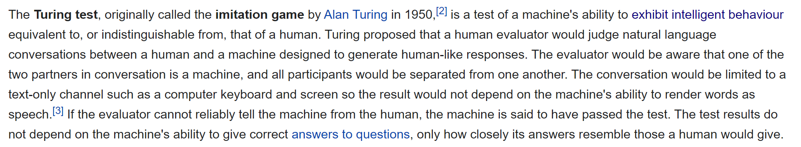
The Turing Test
https://en.wikipedia.org/wiki/Turing_test

Slide 9
Machine Learning Examples
See https://www.businessinsider.com/shane-wighton-robotic-basketball-hoop-cant-miss-2020-5
See https://breakingdefense.com/2020/08/ai-slays-top-f-16-pilot-in-darpa-dogfight-simulation/

Slide 10
Data Management – Stages
Ingestion
Scrubbing & Normalization
Aggregation
Analysis & Intelligence Gathering
Notes:
In the upcoming data engineering session, will talk more about this lifecycle. Machine Learning/AI helps us with complex analysis and intelligence gathering.

Slide 11
History of AI

Slide 12
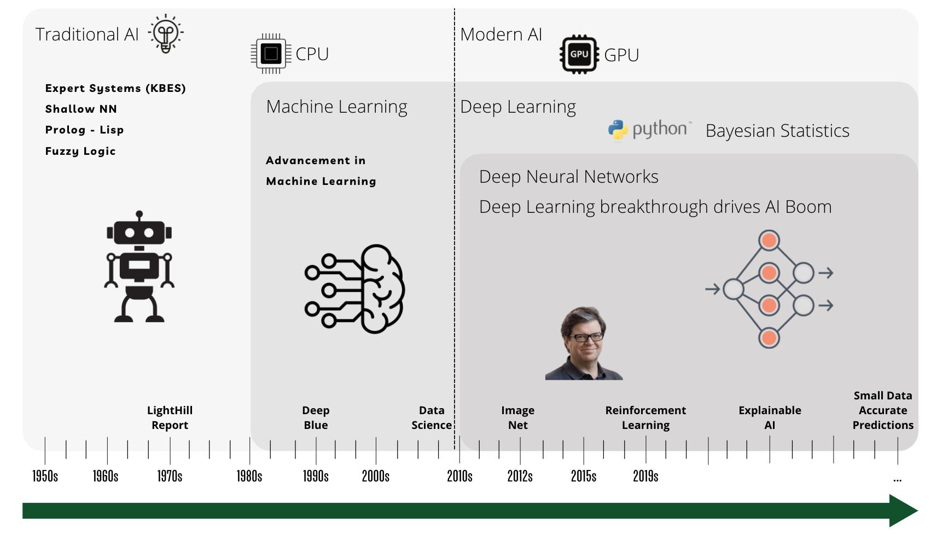
History of AI
Source: awaisbajwa.medium.com

Slide 13

Time for a Quick
Poll
Notes:
When was the term "Artificial Intelligence" coined?
1958
1956
1950
1889

Slide 14
Traditional Systems vs. Machine Learning-Based AI

Slide 15
Traditional Systems vs Machine Learning based AI Systems
Data
Algorithm
Data
Answers
ML Algorithm: Learning Patterns & Rules from Data
Traditional Algorithm: Explicit Programming
of Rules
Data
Model
Trained Model
Answers
Predictions

Slide 16
Learning Algorithm vs Model
Learning Algorithm
Data
Set of instructions that can learn pattern from Data
Applied to
Refined Data
Produces
Model
Approximation of the reality, built using a Learning Algorithm

Slide 17
Time for a Quick
Poll
Notes:
Suppose you are working for a large scale fictitious Social Media Company named as Zetabook. You have been assigned a task to identify the toxic comments on users' posts. To solve this problem at scale which methodology would you be using-
Conventional Programming
Machine Learning Models

Slide 18
Taxonomy of AI

Slide 19
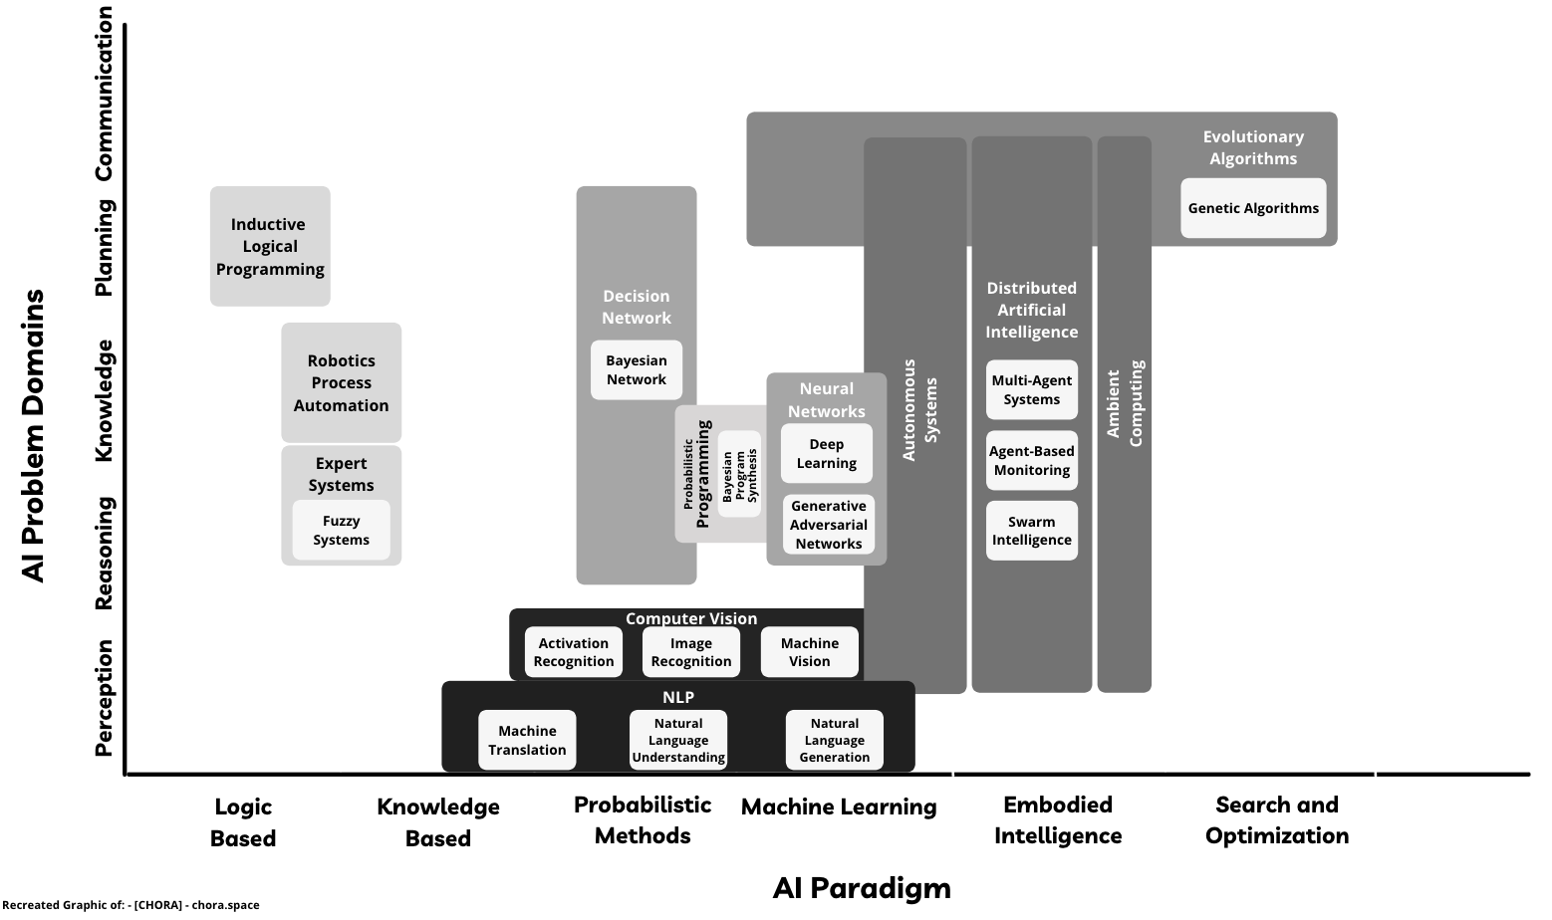
Taxonomy of AI
Scope of Artificial Intelligence is vast & Machine Learning is not the only way of performing Artificial Intelligence

Slide 20
Capabilities & Use Cases

Slide 21

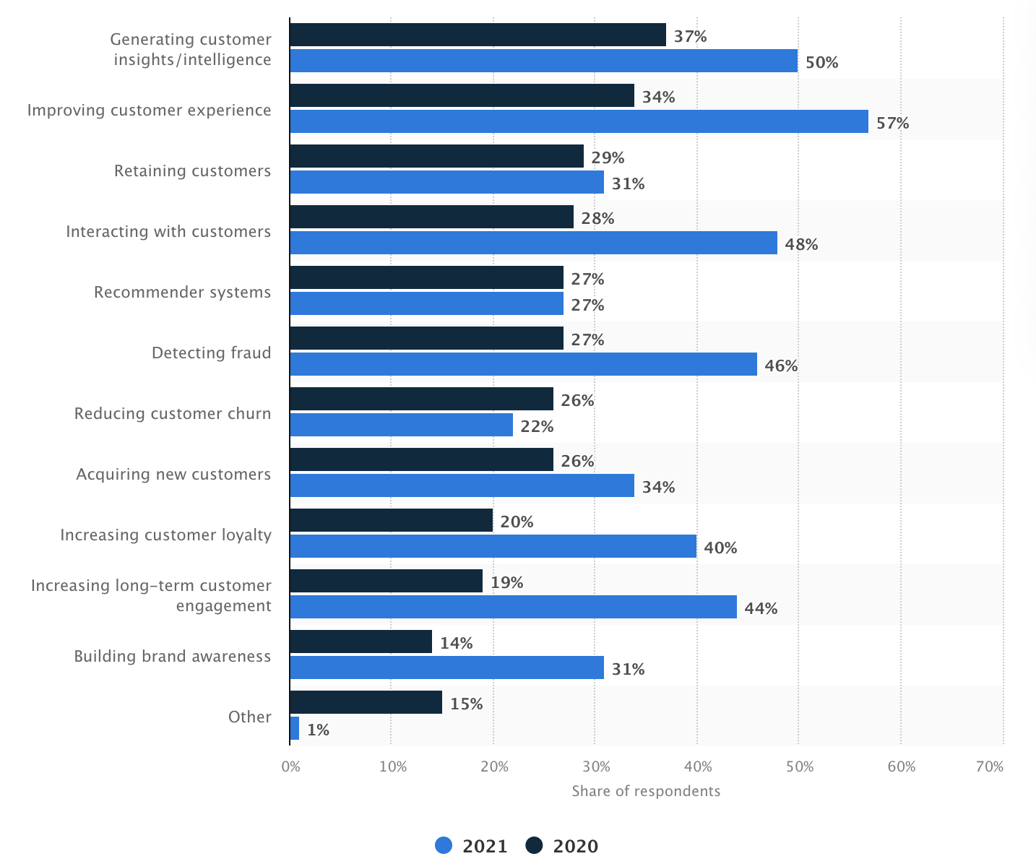






Capabilities & Use Cases
AI & ML Use Cases frequency for companies worldwide
Object Detection
Speech Recognition / Sound Recognition
NLP / Sentiment Analysis
Predictions
Translation between Languages
Restoration & Transformation

Slide 22
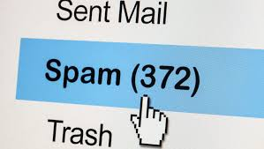
Capabilities & Use Cases
Ham-or-Spam - An Intelligent spam filtering System
Ham-or-Spam is system which is used to classify the mails or messages or texts in two classes i.e., Ham or Spam.
According to Statista, 45.1% percentage of total email traffic are spam in 2021 globally
https://ham-or-spam.herokuapp.com/

Slide 23

Capabilities & Use Cases
Artificial Intelligence can improve the process of Hiring/Recruiting significantly
Establishing a fair recruitment process
Reducing errors in Recruitment Process
Enabling better assessments
Increasing the use of analytics and metrics
Making the process faster and more efficient

Slide 24
AI & Data Science

Slide 25
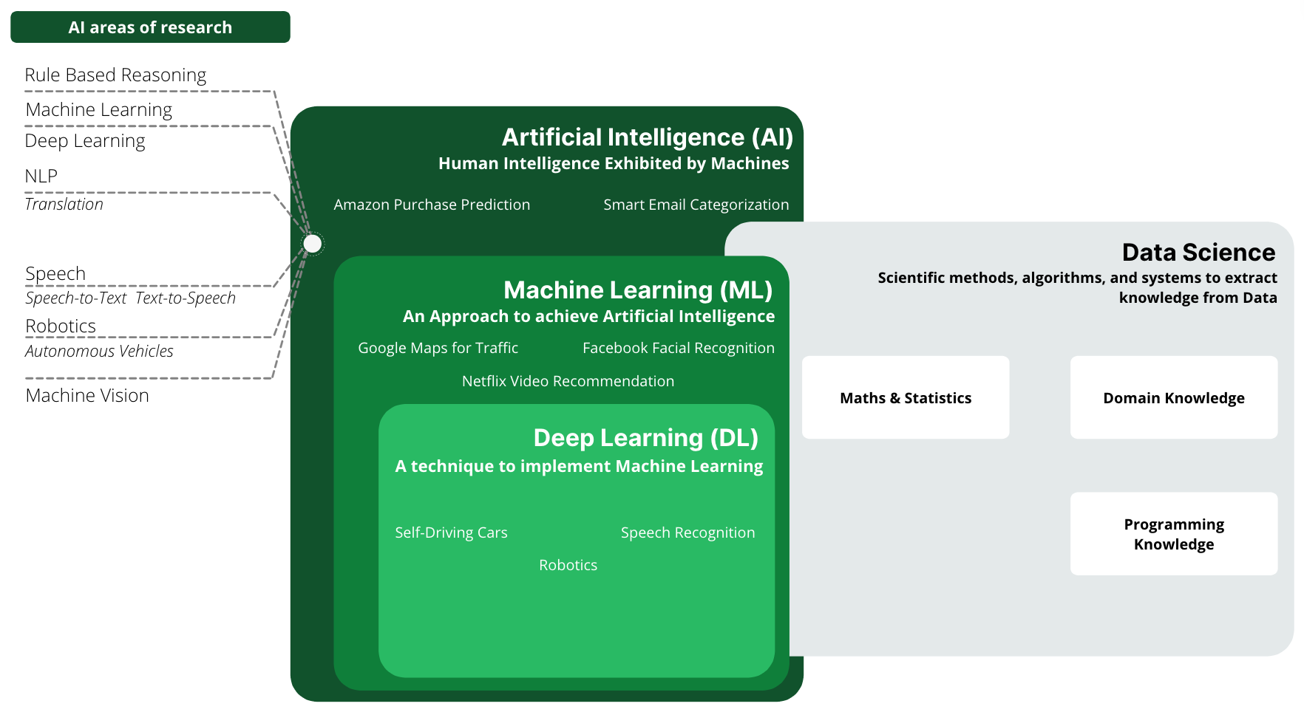
AI & Data Science
Artificial Intelligence is a field which aims to mimic Humans. Machine Learning is sub-set of Artificial Intelligence. Data Science requires Domain Knowledge along with Programming and Mathematical Skills

Slide 26
Data Science Lifecycle
Business
Understanding
Data Acquisition & Understanding
Data Source
On-Premise vs. Cloud Database vs. Files
Start
Pipeline
Streaming vs. Batch
Low vs. High Frequency
Data Science Lifecycle is iterative in nature
Environment
On-Premise vs. Cloud Database vs. Data Lake vs. …
Small vs. Medium vs. Big Data
Wrangling, Exploration, & Cleaning
Structured vs. Unstructured
Data Validation & Cleanup
Visualization
Transformation
Binning
Temporal, Text, & Image
Feature Selection
Feature Engineering
Modeling
Deployment
Algorithms Ensemble
Parameter Tuning
Retraining
Model Management
End
Model Training
Scoring, Performance Monitoring
Cross Validation
Model Reporting
A/B Testing
Model Evaluation
Model Store
Web Services
Intelligent Applications
Recreated graphic of: Microsoft Data Science Lifecycle

Slide 27
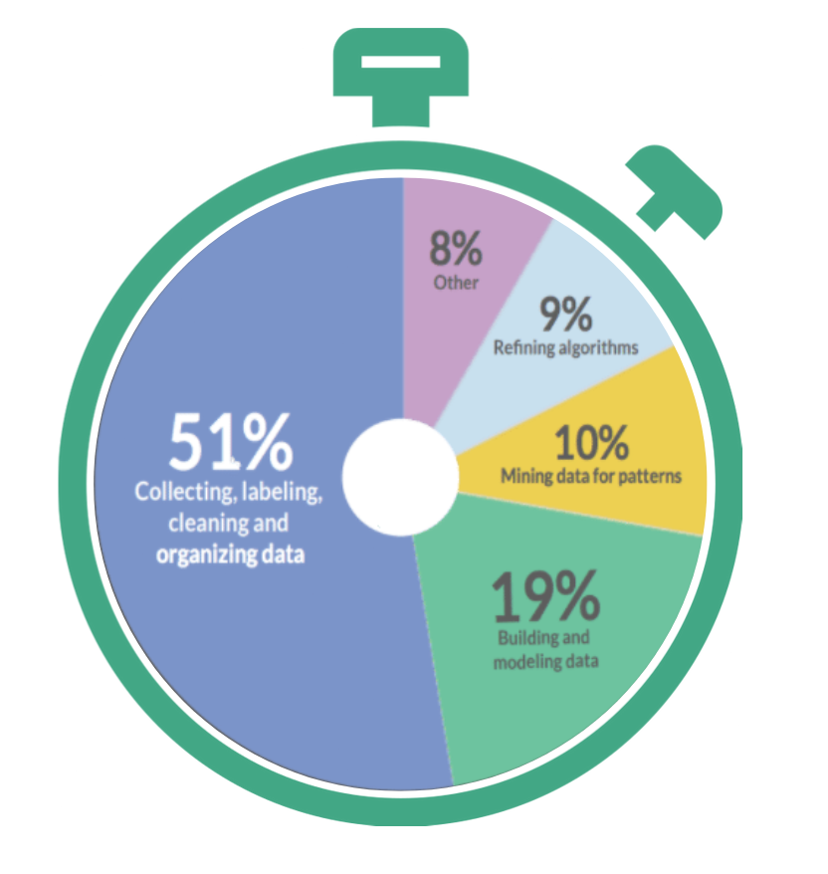
Various Activities in Data Science Project
During Data Science project, significant Time goes into Data Wrangling
What activities take most of the Time of Data Scientists?
Source:Hackernoon

Slide 28
Machine Learning Pipeline
A Pipeline is a standard way of implementing Machine Learning
Learning Model Parameters
Finding Best Hyperparameter
Data Acquisition
Data Pre-Preparation
Choose ML Models
Train ML Models
Evaluate ML Model
Model Tuning
For Example - Linear Regression, XGBoost, etc.
Model Deploy
Model Maintenance
Model Monitoring
Model Prediction

Slide 29
Time for a Quick
Poll
Notes:
What is the correct sequence of the process pipeline for executing a successful Data Science process?
Data Acquisition, Feature Engineering, Modeling, Deployment
Feature Engineering, Data Acquisition, Modeling, Deployment
Data Acquisition, Modeling, Feature Engineering, Deployment

Slide 30

DEMO
Analyze Text
Notes:
Execute https://learn.microsoft.com/en-us/azure/storage/blobs/blob-upload-function-trigger?tabs=azure-portal on Azure or https://aws.amazon.com/getting-started/hands-on/analyze-sentiment-comprehend/#:~:text=with%20Amazon%20Comprehend%201%20Step%201.%20Create%20an,Step%204.%20Compare%20results%20of%20text%20sentiment%20analyses on AWS

Slide 31
Types of Machine Learning

Slide 32
Types of Machine Learning
Machine Learning
Supervised
How it works?
Step 1. Label input data that defines output variables.
Step 2. Train the algorithm on the data to find the connection between input variables and output.
Step 3. Once training is completed, then apply the algorithm to new data.
What is Supervised Learning?
An algorithm uses training data and feedback from human users to learn the relationship between given inputs and a given output

Slide 33
Types of Machine Learning
Machine Learning
Supervised
Unsupervised
How it works?
What is Unsupervised Learning?
Step 1. Algorithm receives unlabeled data.
Step 2. It infers the schema from the data.
Step 3. The algorithm identifies groups of data that exhibit similar behavior.
It is more exploratory in nature. An algorithm explores relationships in input data without being provided an explicit output variable.

Slide 34
Types of Machine Learning
Machine Learning
Supervised
Unsupervised
Reinforcement
What is Reinforcement Learning?
How it Works?
An algorithm learns to perform task simply by trying to maximize the rewards it would receive for its actions.
Step 1. Algorithm takes an action affecting the environment.
Step 2. It receives a reward if the action brings the machine a step closer to max. available reward.
Step 3. The algorithm optimizes for the best series of actions by correcting itself over time.
Algorithms
REWARD
STATE
ACTION
Environment

Slide 35
Types of Machine Learning
Machine Learning
Supervised
Unsupervised
Reinforcement
Regression
Clustering
Self Driving Cars
Classification
Recommender Systems
Playing Games

Slide 36
Understanding ML Algorithms in an Intuitive Way

Slide 37
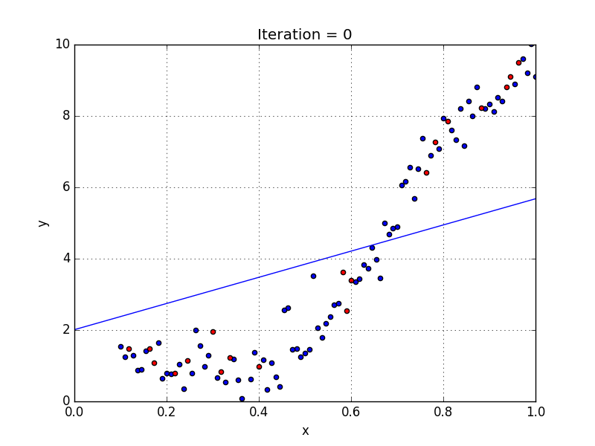
Understanding ML Algorithms in an Intuitive Way- Linear Regression
Linear Regression
It models a linear relationship between a continuous response variable and one or more explanatory variables.
E.g., modeling price of house based on area
Source: Towards Data Science

Slide 38
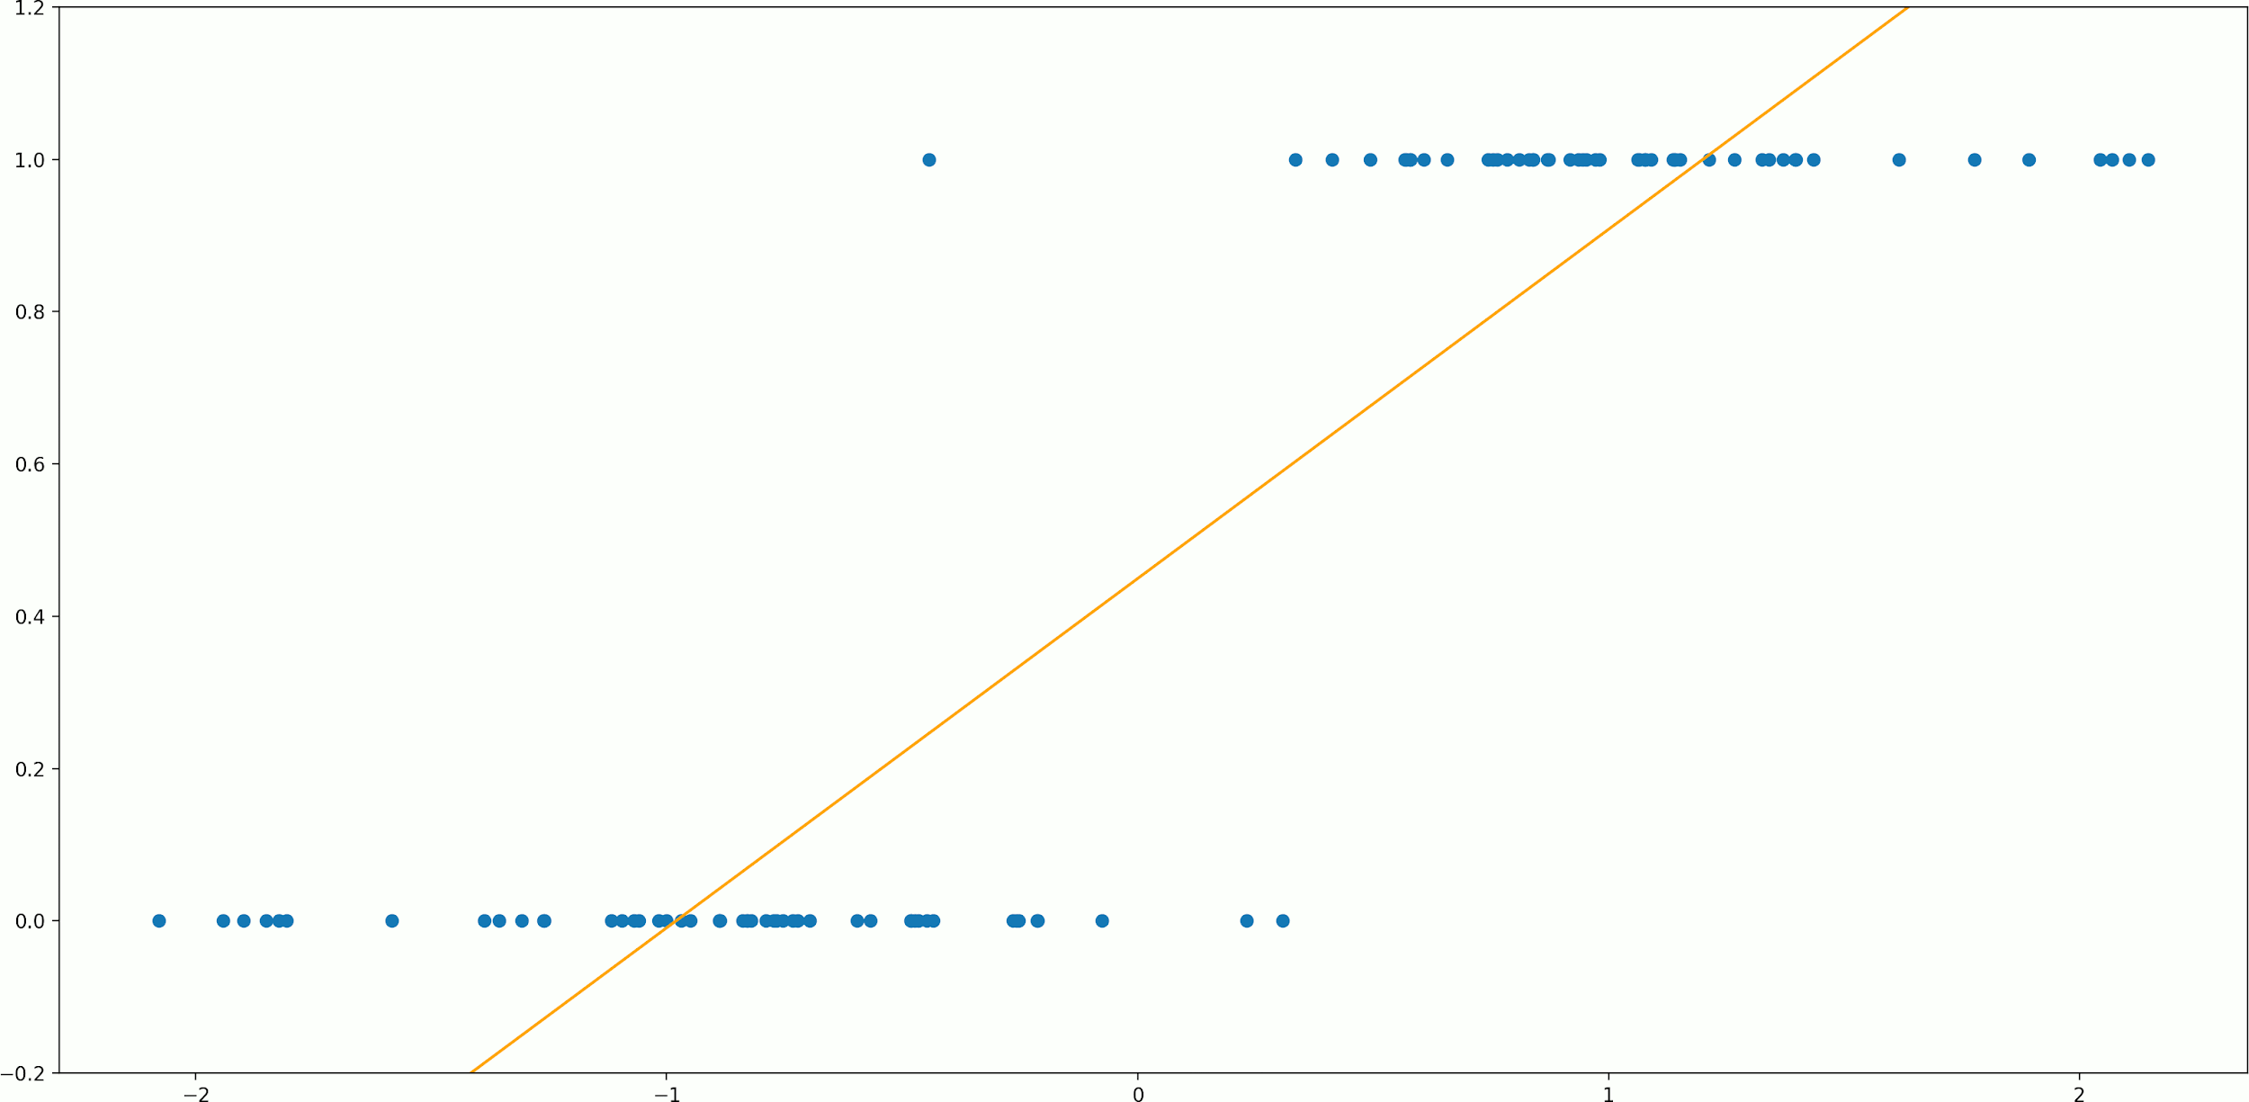
Understanding ML Algorithms in an Intuitive Way- Logistic Regression
Logistic Regression
It is a probabilistic model giving output as probability between 0 and 1.
E.g., modeling whether customer will leave Telecom Service provider or not
Source: Dorian Lazar

Slide 39
Deep Learning

Slide 40
Deep Learning
Deep Learning often outperforms traditional ML methods
% reduction in error rate achieved by deep learning vs. traditional ML methods
41%
Deep Learning can find complex patterns from the data and produce more accurate results than traditional ML approaches
27%
25%
41%
Image Classification
Facial
Recognition
Voice
Recognition
Source: Mckinsey

Slide 41
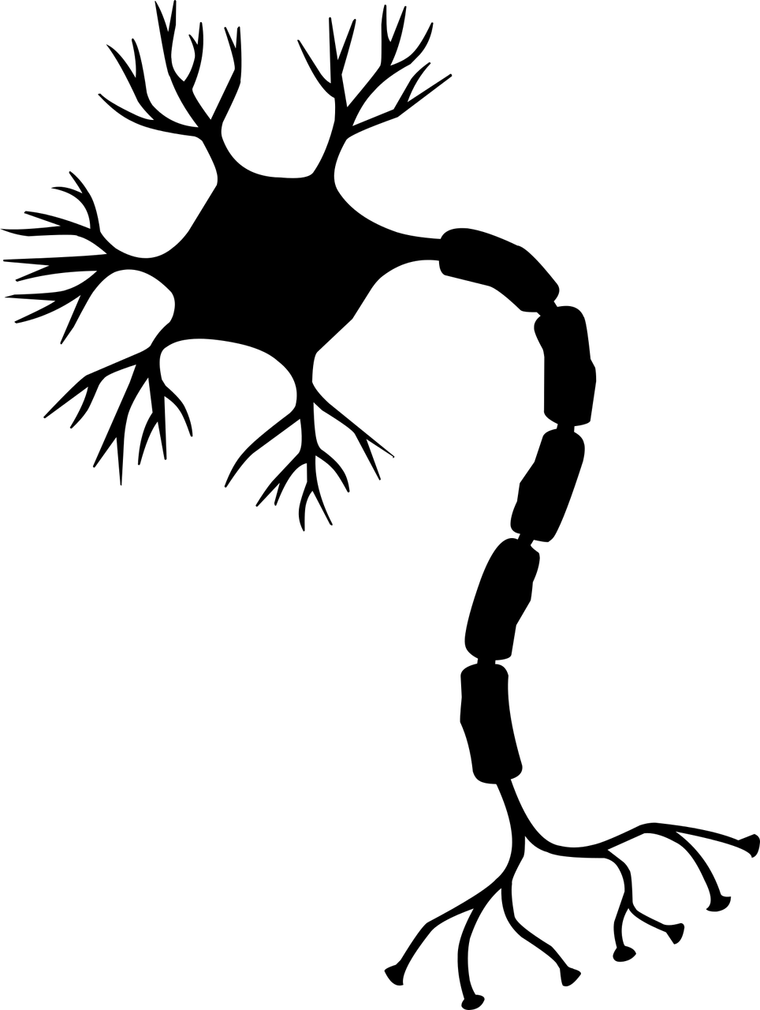
Deep Learning - Artificial Neural Network
The Global market for ANN applications is projected to grow from $177m to $296m by 2024, at a CAGR of 20.4%.
CAGR
Artificial Neural Networks are a very rough imitation of the brain's structure
20.4%
Human Brain Neuron
Artificial Neural Network
Input
$296m
Hidden Layer
$117m
Output
Input
Hidden Layer
Output
2019
2024
Source: MarketsAndMarkets

Slide 42

Deep Learning - Artificial Neural Network
“Profound Learning and Artificial Neural Networks (ANN) have fueled the adoption of AI in several industries, such as aerospace, healthcare, manufacturing, and automotive. ANN is substituting conventional machine learning systems to evolve precise and accurate versions” - Grand View Research
BecomingHuman.ai

Slide 43
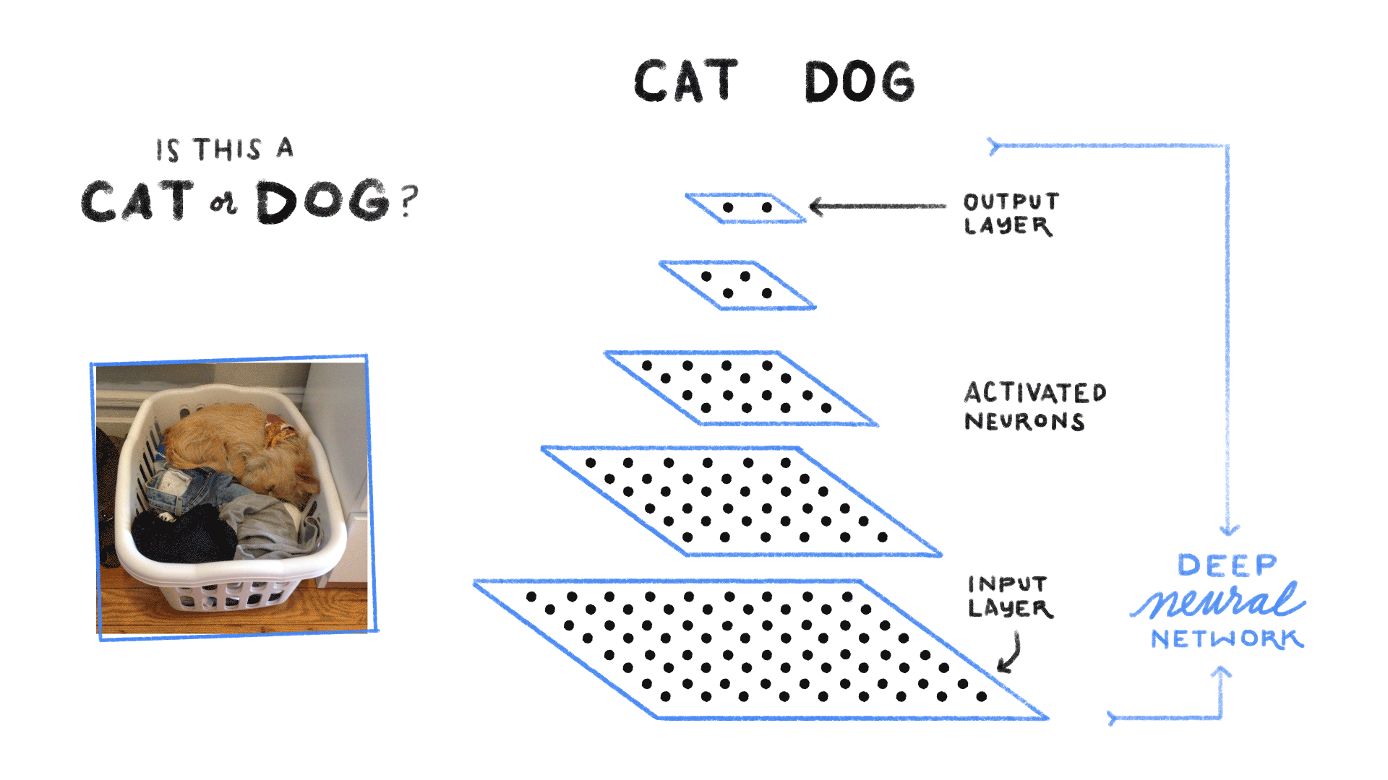

Deep Learning - Artificial Neural Network
BecomingHuman.ai

Slide 44
DEMO
Analyze Image
Notes:
Execute https://learn.microsoft.com/en-us/azure/azure-functions/functions-machine-learning-tensorflow?tabs=bash on Azure or https://app.pluralsight.com/labs/detail/d62b4745-b08d-4989-9b5e-5907d9a28561/toc on AWS

Slide 45
Ways to Implement AI

Slide 46
Ways to perform AI/ML
Requirements, Skillset, Compute, & Availability of Data influence the choice of approach
Less Flexible
More Flexible
Easiest Approach
Most complex Approach
Cognitive API
Auto ML
Transfer Learning
Build your own Model (BYOM)

Slide 47




Ways to perform AI/ML
Less Flexible / Easiest Approach
More Flexible / Most complex Approach
Cognitive API
Useful when you want to use pre-built models
Make a REST Based API call to invoke it
No Machine Learning skills required
Least flexible option
Text-to-Speech API
NLP
Vision API
Translate API
Speech-to-Text API
NLP API

Slide 48


Ways to perform AI/ML
Less Flexible / Easiest Approach
More Flexible / Most complex Approach
Cognitive API
Auto ML
An approach to automate Data Scientist’s work
Based on the concept “Using AI to Build AI”
No ML expertise required but correct data labeling necessary
Not much flexibility in terms of customization
Good for problems where you have an abundance of clean data and limited bandwidth of AI teams
10x
Increase in Data Science Team Productivity
54%
Less TCO compared to another Clouds
Spend Time on What matters to you
AutoML for all
Full Transparency
End-to-End Solutions
Source: Amazon Sagemaker

Slide 49
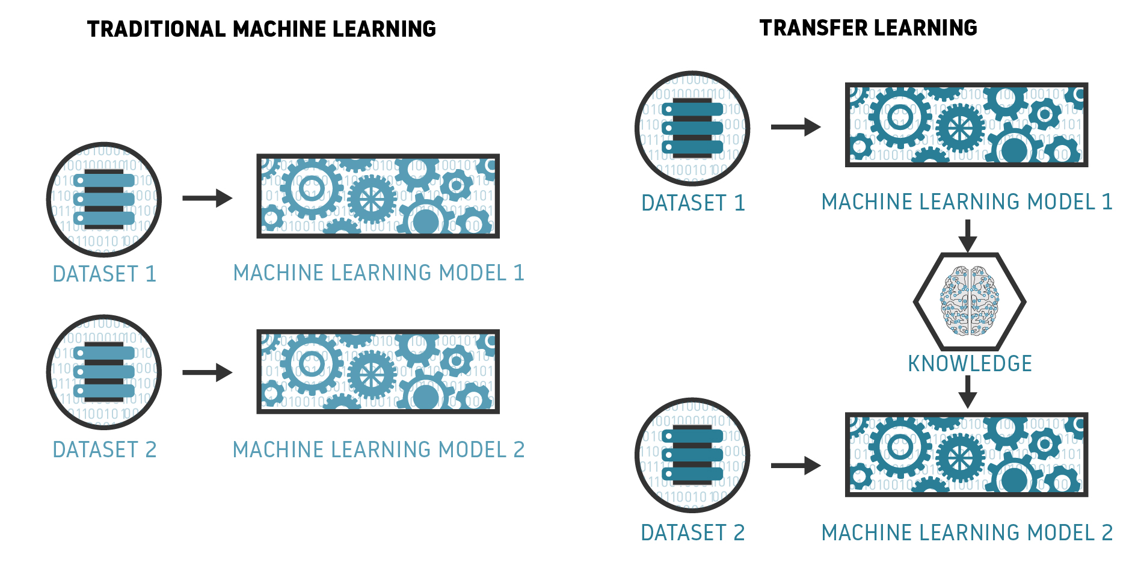
Ways to perform AI/ML
Less Flexible / Easiest Approach
More Flexible / Most complex Approach
Cognitive API
Auto ML
Transfer Learning
Reuse experts’ knowledge
Requires Machine Learning expertise
Saves a lot of time and computational expense in model training
Provides some flexibility to fine-tune models
Requires relatively less data
TensorFlow Hub has many pre-built models
Source: bosem.in

Slide 50

Ways to perform AI/ML
Less Flexible / Easiest Approach
More Flexible / Most complex Approach
Cognitive API
Auto ML
Transfer Learning
Build Your Own Model
Most Flexible Approach
Requires Machine Learning Expertise
TensorFlow, Keras, PyTorch, etc., are the most commonly used libraries
Most used ML libraries and frameworks among developers
TensorFlow
16.53%
Keras
10.14%
PyTorch
9.89%
Apache
Spark
5.83%
Hadoop
4.43%

Slide 51
Time for a Quick
Poll
Notes:
Which of the following is not a type of Machine Learning?
Supervised
Un-Supervised
Explainable ML
Reinforcement Learning

Slide 52
DEMO
Assessing Sentiment
Notes:
Execute https://learn.microsoft.com/en-us/azure/azure-functions/functions-twitter-email on Azure or https://aws.amazon.com/getting-started/hands-on/sentiment-analysis-amazon-aurora-ml-integration/ on AWS

Slide 53




Thank you!
If you have additional questions, please reach out to me at:
(email address)

